Slide 1

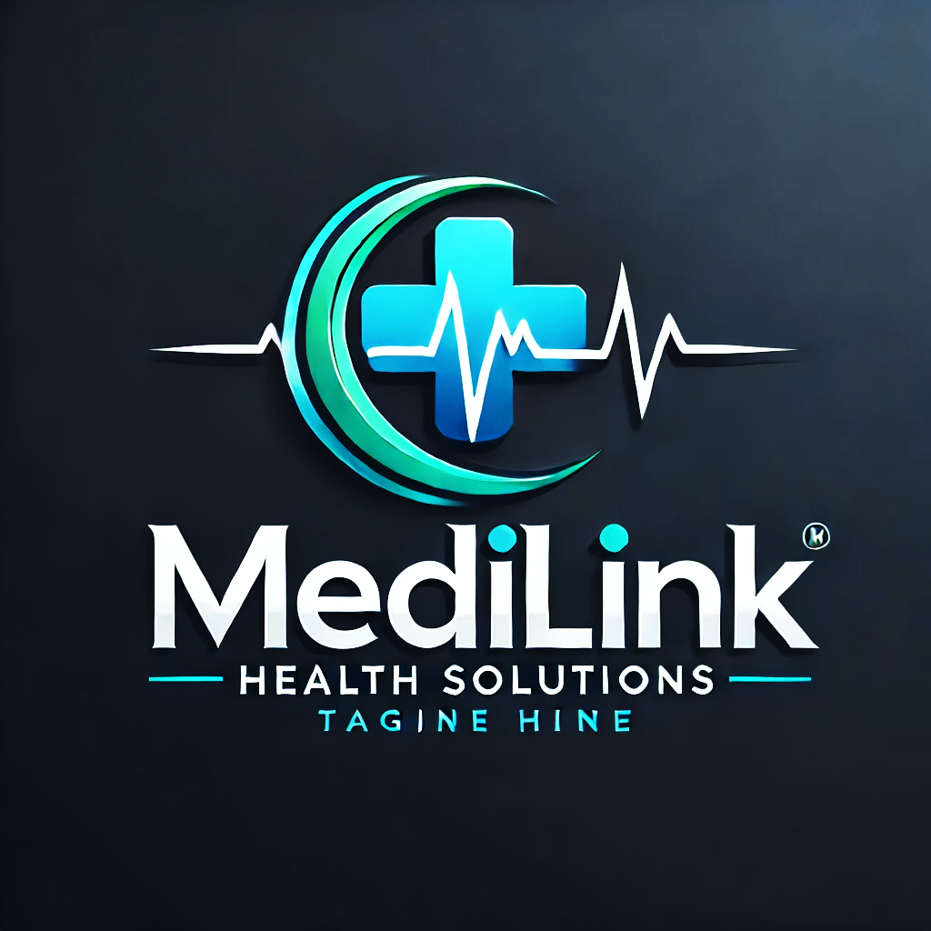
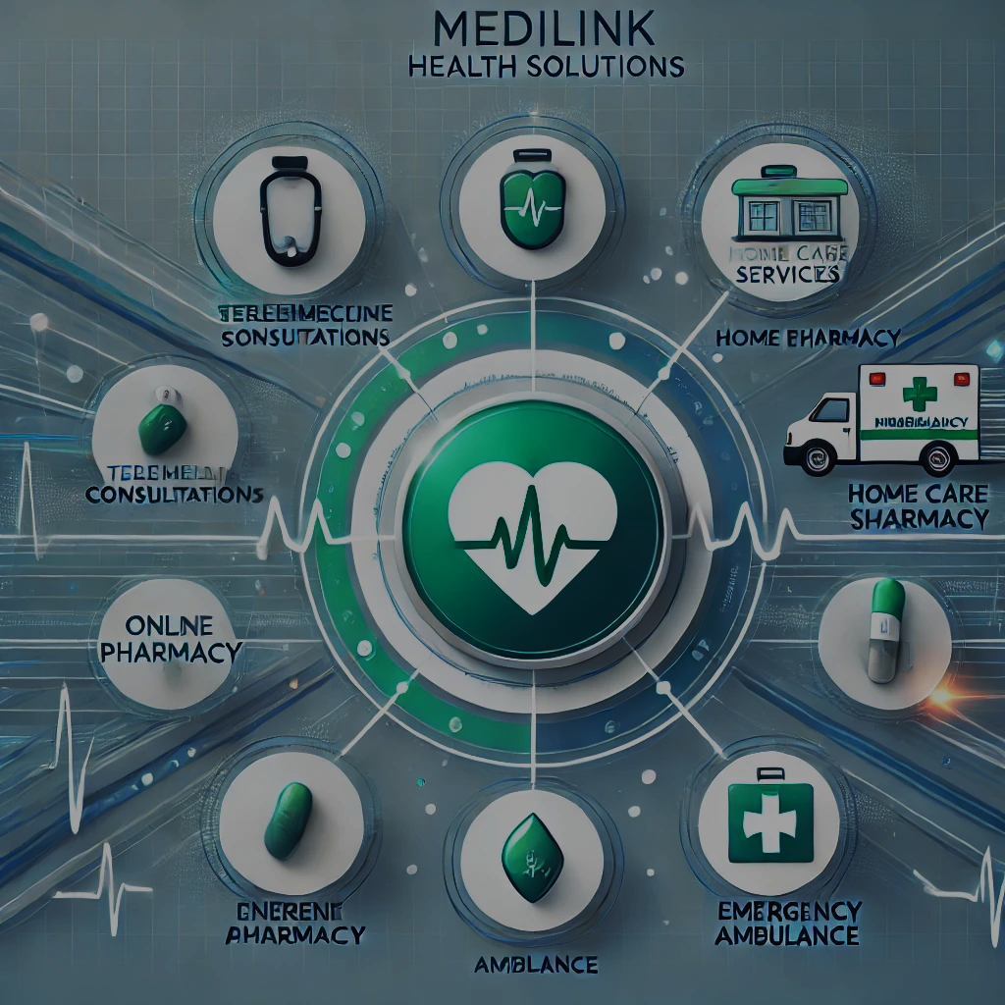
📌 🩺 WHO WE ARE MediLink Health Solutions is a modern healthcare provider offering high-quality, affordable, and accessible medical services. We combine advanced technology with compassionate care to help you live a healthier life. 👉 "Your health is our purpose, your trust is our promise." 📌 🚀 OUR MISSION To revolutionize healthcare access by providing convenient, reliable, and patient-centered services through innovation and technology. 👉 "Behind every patient is a story—we’re here to listen, care, and heal." 📌 💡 WHY YOU SHOULD CHOOSE US: Competitive Edge ✅ 24/7 Healthcare: Consult doctors anytime via our telemedicine app. ✅ Expert Professionals: Certified and experienced medical staff. ✅ Affordable Services: High-quality care that fits your budget. ✅ Technology-Driven: Online appointments, digital health records, and telemedicine. ✅ Community Focused: Free health check-up campaigns monthly. 👉 "Committed to Connecting Care with Compassion."
📌 💙 OUR SERVICES (PANEL 5): Offerings That Matter ✔️ Telemedicine Consultations: Consult doctors from anywhere. ✔️ Home Care Services: Nurses at your doorstep. ✔️ Pharmacy: Online ordering and quick delivery. ✔️ Health Screening: Check-ups for blood pressure, diabetes, and more. ✔️ Wellness Programs: Fitness, diet, and mental health counseling. ✔️ Emergency Ambulance: Quick response for urgent needs. 👉 "Innovating today for a healthier tomorrow.“ 📌 📞 Contact Information & Call to Action Get in Touch: 📍 Address: Kigali City Center, Rwanda 📞 Phone: +250 78XXXXXXX 📧 Email: contact@medilink.rw 🌐 Website: www.medilink.rw Social Media: 📲 Instagram: @medilink_rw 📲 Facebook: MediLink Health Solutions
MEDLINK HEALTH SOLTIONS Caring for You, Innovating for Tomorrow

